Slide 1

Flip Robo Technologies: Internship Batch 34
CAUSE OF DEATH

Slide 2
1. INTRODUCTION

Slide 3
INTRODUCTION
A straightforward way to assess the health status of a population is to focus on mortality – or concepts like child mortality or life expectancy, which are based on mortality estimates. A focus on mortality, however, does not take into account that the burden of diseases is not only that they kill people, but that they cause suffering to people who live with them. Assessing health outcomes by both mortality and morbidity (the prevalent diseases) provides a more encompassing view on health outcomes.

Slide 4
DISABILITY ADJUSTED LIFE YEARS(DALYs)
The sum of mortality and morbidity is referred to as the ‘burden of disease’ and can be measured by a metric called ‘Disability Adjusted Life Years‘ (DALYs). DALYs are measuring lost health and are a standardized metric that allow for direct comparisons of disease burdens of different diseases across countries, between different populations, and over time. Conceptually, one DALY is the equivalent of losing one year in good health because of either premature death or disease or disability. One DALY represents one lost year of healthy life. The first ‘Global Burden of Disease’ (GBD) was GBD 1990 and the DALY metric was prominently featured in the World Bank’s 1993 World Development Report. Today it is published by both the researchers at the Institute of Health Metrics and Evaluation (IHME) and the ‘Disease Burden Unit’ at the World Health Organization (WHO), which was created in 1998. The IHME continues the work that was started in the early 1990s and publishes the Global Burden of Disease study.

Slide 5
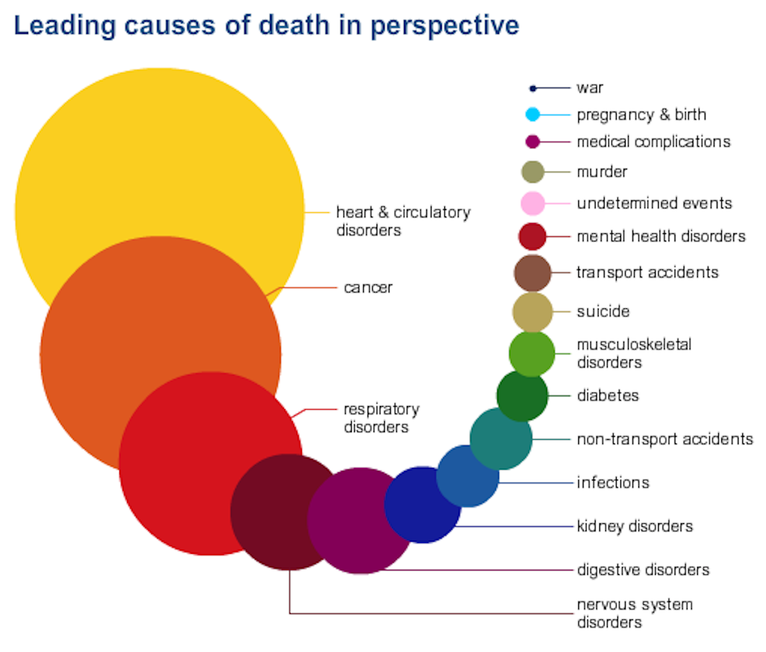
LEADING CAUSES OF DEATH

Slide 6
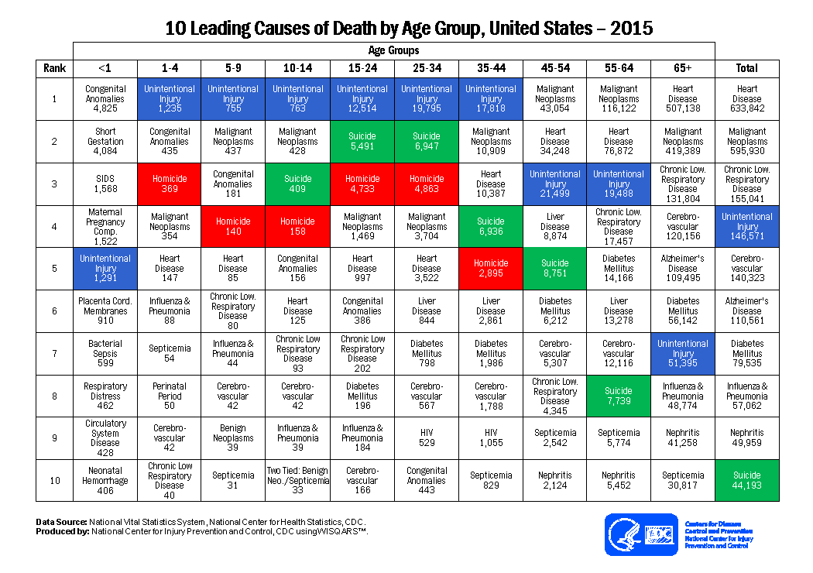
LEADING CAUSE OF DEATH BY AGE GROUP, USA

Slide 7
UNDERSTANDING FROM PREVIOUS DATA CHART:
01
02
03
04
Maximum deaths due to suicide happened to the age of 15-34 years
Major deaths happened between the age of 25-44 years.
Maximum deaths due to unintentional injuries happened to the age of 45-54 years
Maximum deaths due to homicide happened to the age of 25-34 years.

Slide 8
RESEARCH OBJECTIVES
This research paper has the following objectives:
Data Scientists have to apply their analytical skills to give findings and conclusions in detailed data analysis written in jupyter notebook . Only data analysis is required.

Slide 9
RESEARCH METHODOLOGY
RESEARCH DESIGN
The research design is the conceptual framework around which the survey is undertaken. Here a part of the research undertaken is a Exploratory Research as it is describing the perception of the respondents.
SAMPLE SIZE
The Sample Size is 6120. Data has been collected and analysed on the basis of the responses. The research was conducted with an aim of getting respondents from all across the world.

Slide 10
RESEARCH METHODOLOGY
PERIOD OF STUDY
The period of study was more than a week.
DATA COLLECTION
Primary Data- Dataset and Data description provided by Flip Robo technologies for project completion.
Secondary Data-The data includes reference from previously published research papers, journals, books and articles.
METHOD OF ANALYSIS
In this research, tables and various types of graphs such as bar graph and count plot have been used. This helped to present the data in a meaningful way and making it easily understandable.

Slide 11
DATASET CONTENT
Country Or Region : Countries in the world or Regions
Code : Country ISO Code
Year : Year
Number of executions (Amnesty International) : Executions count by the countries
Deaths - Meningitis : Meningitis -> Meningitis is an inflammation (swelling) of the protective membranes covering the brain and spinal cord
Deaths - Neoplasms : Tumors -> Any growth that develops inside or on the body
Deaths - Fire, heat, and hot substances : Death by the high temperature (Not the blood temparature, Depends the environment)
Deaths - Malaria : Malaria -> Malaria is a serious and sometimes fatal disease caused by a parasite that commonly infects a certain type of mosquito which feeds on humans
Deaths - Drowning : Drowning -> Drowning is the process of experiencing respiratory impairment from submersion or immersion in liquid.
Deaths - Interpersonal violence : Interpersonal violence -> The intentional use of physical force or power against other persons by an individual or small group of individuals
Deaths - HIV/AIDS : HIV is a virus that attacks the body’s immune system. If HIV is not treated, it can lead to AIDS (acquired immunodeficiency syndrome)
Deaths - Drug use disorders : Death, depends Drug use disorders

Slide 12
DATASET CONTENT
Deaths - Tuberculosis : Tuberculosis is caused by a bacterium. The bacteria usually attack the lungs, but TB bacteria can attack any part of the body such as the kidney, spine, and brain
Deaths - Road injuries : Road traffic injuries are defined as “fatal or non-fatal injuries incurred as a result of a road traffic crash
Deaths - Maternal disorders : Maternal Mental Health (MMH) disorders include a range of disorders and symptoms, including but not limited to depression, anxiety and psychosis
Deaths - Lower respiratory infections : Lower respiratory tract infections are any infections in the lungs or below the voice box.
Deaths - Neonatal disorders : Neonatal disorders mean disturbance of normal state of body, organs and abnormal function of a newborn
Deaths - Alcohol use disorders : Death, depends Alcohol
Deaths - Exposure to forces of nature : Definition A force that is beyond human control. This Includes earthquakes, volcanic eruptions, avalanches, storms, lightning strikes, and floods
Deaths - Diarrheal diseases : Diarrheal diseases are a collection of diseases caused by multiple viral, bacterial, and parasitic organisms that share the common symptom of diarrhea
Deaths - Environmental heat and cold exposure : Environmental heat and cold exposure
Deaths - Nutritional deficiencies : Nutritional deficiency occurs when the body is not getting enough nutrients such as vitamins and minerals
Deaths - Self-harm : Self-harm. Like a suicide

Slide 13
DATASET CONTENT
Deaths - Conflict and terrorism : Death, depends conflict and terrorism
Deaths - Diabetes mellitus : Diabetes mellitus refers to a group of diseases that affect how your body uses blood sugar (glucose)
Deaths - Poisonings : A poison is any substance that is harmful to your body. You might swallow it, inhale it, inject it, or absorb it through your skin
Deaths - Protein-energy malnutrition : An imbalance between the supply of protein and energy and the body's demand for them to ensure optimal growth and function
Deaths - Cardiovascular diseases : Cardiovascular disease (CVD) is a general term for conditions affecting the heart or blood vessels
Deaths - Chronic kidney disease : Chronic kidney disease is a long-term condition where the kidneys don't work as well as they should. It's a common condition often associated with getting older
Deaths - Chronic respiratory diseases : Chronic respiratory disease is an umbrella term to describe diseases that affect the lungs and airways. Common types include: asthma, cystic fibrosis, lung cancer and sleep apnea
Deaths - Cirrhosis and other chronic liver diseases : Cirrhosis is when scar tissue replaces healthy liver tissue. This stops the liver from working normally. Cirrhosis is a long-term (chronic) liver disease
Deaths - Digestive diseases : A digestive disease is any health problem that occurs in the digestive tract
Deaths - Acute hepatitis : Acute hepatitis is a term used to describe a wide variety of conditions characterized by acute inflammation of the hepatic parenchyma or injury to hepatocytes resulting in elevated liver function indices
Deaths - Alzheimer's disease and other dementias : Dementia is a general term for a decline in mental ability severe enough to interfere with daily life. Alzheimer's is the most common cause of dementia. Alzheimer's is a specific disease
Deaths - Parkinson's disease : Parkinson's disease is a brain disorder that leads to shaking, stiffness, and difficulty with walking, balance, and coordination.

Slide 14
2. STEPS USED IN EDA OF CAUSE OF DEATH DATASET

Slide 15
Steps:
1. Identification of variables and data types
2. Analyzing the basic metrics
3. Non-Graphical Univariate Analysis
4. Missing value treatment
5. Graphical Univariate Analysis
6. Bivariate Analysis
7. Multivariate Analysis using correlation
8. Correlation using heat map
9. Describing the dataset
10. Dataset Info

Slide 16
3. ANALYSIS: DATA FINDINGS AND INTERPRETATION

Slide 17
3.1 Data shapes and Data types

Slide 18
Shape of DataFrame:
The shape property returns a tuple containing the number of rows and columns of the DataFrame.
Data Types:
Pandas dtype mapping
Pandas dtype | Python type | NumPy type | Usage
object | str or mixed | string_, unicode_, mixed types | Text or mixed numeric and non-numeric values
int64 | Int | int_, int8, int16, int32, int64, uint8, uint16, uint32, uint64 | Integer numbers
float64 | Float | float_, float16, float32, float64 | Floating point numbers
bool | Bool | bool_ | True/False values
datetime64 | NA | datetime64[ns] | Date and time values
timedelta[ns] | NA | NA | Differences between two datetimes
category | NA | NA | Finite list of text values

Slide 19
3.2 Data Visualization We will use countplot, displot for univariate analysis and scatterplot for bivariate analysis. For multivariate analysis we will use correlation and heatmap.

Slide 20
UNIVARIATE ANALYSIS

Slide 21
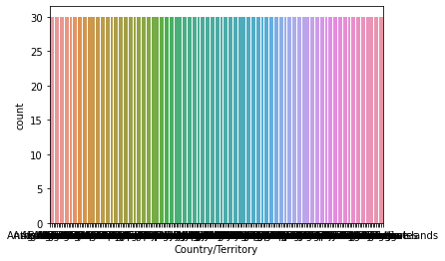
COUNTRY/TERRITORY-
Afghanistan 30 Papua New Guinea 30 Niue 30 North Korea 30 North Macedonia 30 .. Greenland 30 Grenada 30 Guam 30 Guatemala 30 Zimbabwe 30.
We see that count of all countries/territories are the same- 30.

Slide 22
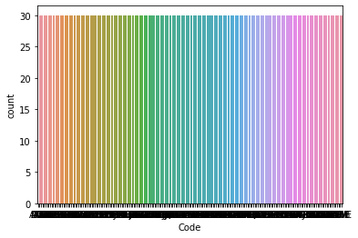
CODE-
AFG 30
PNG 30
NIU 30
PRK 30
MKD 30
..
GRL 30
GRD 30
GUM 30
GTM 30
ZWE 30

Slide 23
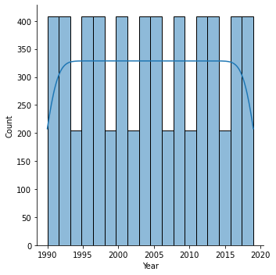
YEAR-
Here, we see that some years have been seen 400 times while some have been seen 200 times.

Slide 24
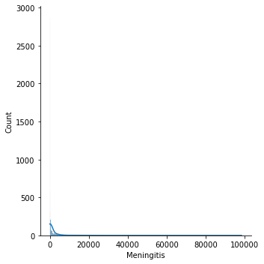
MENINGITIS-

Slide 25
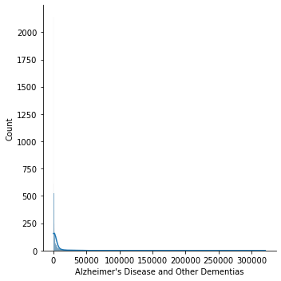
ALZHEIMER’S DISEASE AND OTHER DEMENTIS-

Slide 26
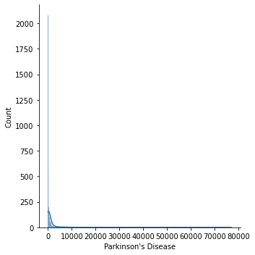
PARKINSON’S DISEASE-

Slide 27
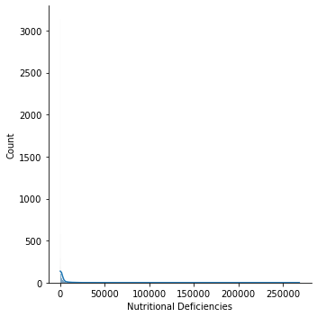
NUTRITIONAL DEFICIENCIES-

Slide 28
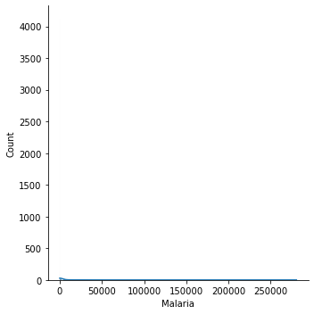
MALARIA-

Slide 29
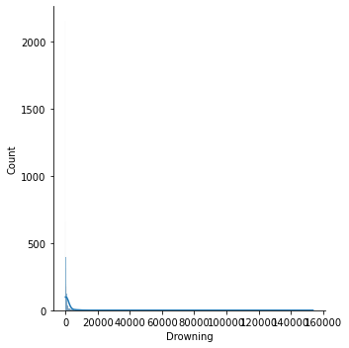
DROWNING-

Slide 30
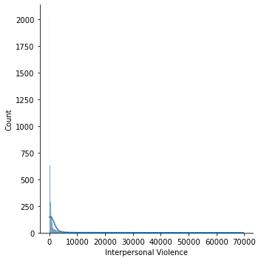
INTERPERSONAL VIOLENCE-

Slide 31
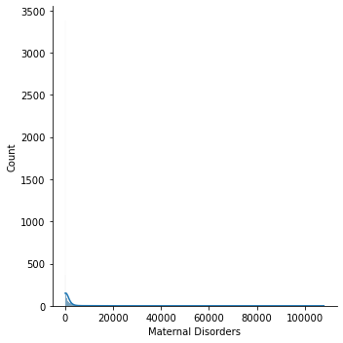
MATERNAL DISORDERS-

Slide 32
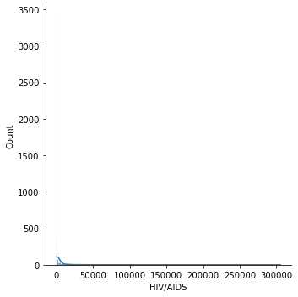
HIV/AIDS

Slide 33
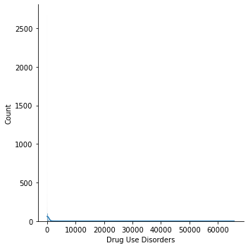
DRUG USE DISORDERS

Slide 34
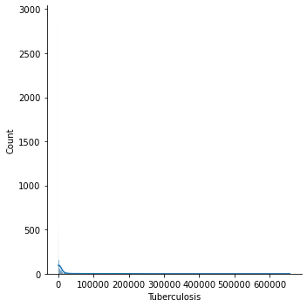
TUBERCULOSIS

Slide 35
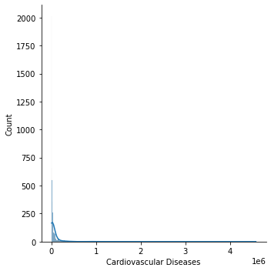
CARDIOVASCULAR DISEASES-

Slide 36
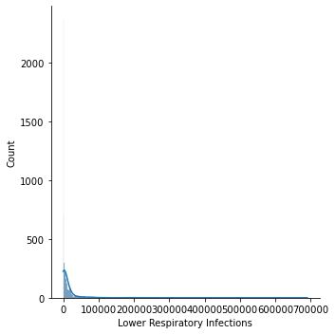
LOWER RESPIRATORY INFECTIONS

Slide 37
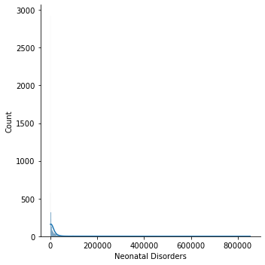
NEONATAL DISORDERS-

Slide 38
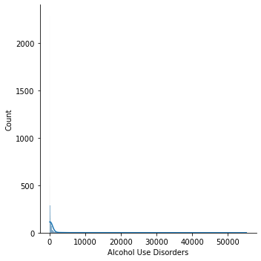
ALCOHOL USE DISORDERS-

Slide 39
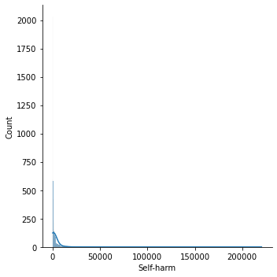
SELF-HARM-

Slide 40
BIVARIATE ANALYSIS
We will use all the column names as y axis and Year column as x axis to interpret the cause of death in relation to the year.

Slide 41
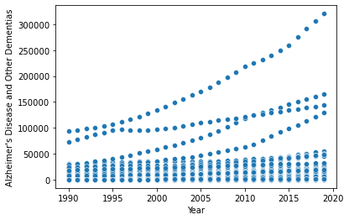
ALZHEIMER’S DISEASE AND OTHER DEMENTIAS-
Here, we see that , maximum of this kind of deaths were caused in the year 2015-2020. The graph is sloping upwards which is dangerous.

Slide 42
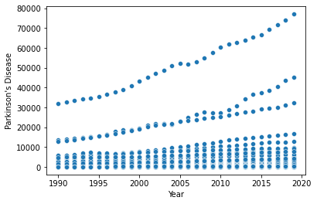
PARKINSON’S DISEASE-
Here, we see that , maximum of this kind of deaths were caused in the year 2015-2020. The graph is sloping upwards which is dangerous.

Slide 43
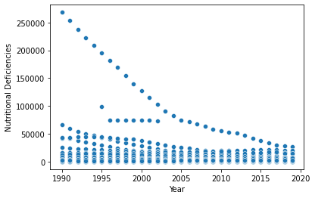
NUTRITIONAL DEFICIENCIES -
Here, we see that , maximum of this kind of deaths were caused in the year 1990-1995. The graph is sloping downwards which is not dangerous.

Slide 44
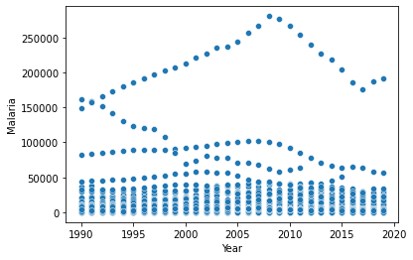
MALARIA-
Here, we see that , maximum of this kind of deaths were caused in the year 2005-2010. The graph is sloping downwards which is not dangerous.

Slide 45
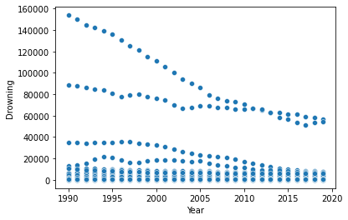
DROWNING-
Here, we see that , maximum of this kind of deaths were caused in the year 1990-1995. The graph is sloping downwards which is not dangerous.

Slide 46
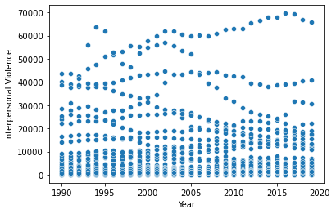
INTERPERSONAL VIOLENCE-
Here, we see that , maximum of this kind of deaths were caused in the year 2015-2020. The graph is sloping downwards which is not dangerous.

Slide 47
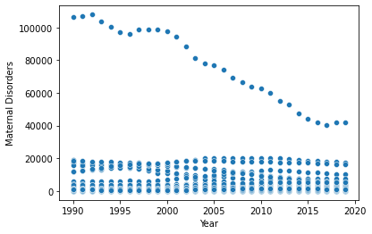
MATERNAL DISORDERS-
Here, we see that , maximum of this kind of deaths were caused in the year 1990-1995. The graph is sloping downwards which is not dangerous.

Slide 48
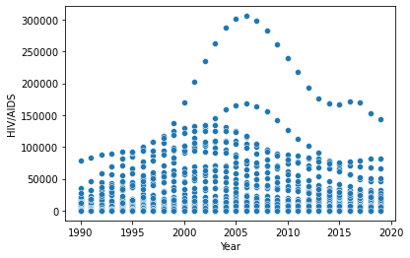
HIV/AIDS-
Here, we see that , maximum of this kind of deaths were caused in the year 2005-2010. The graph is sloping downwards which is not dangerous.

Slide 49
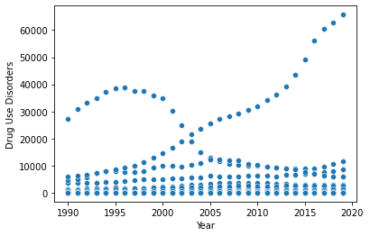
DRUG USE DISORDERS-
Here, we see that , maximum of this kind of deaths were caused in the year 2015-2020. The graph is sloping upwards which is dangerous.

Slide 50
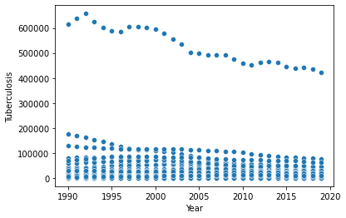
TUBERCULOSIS-
Here, we see that , maximum of this kind of deaths were caused in the year 1990-1995. The graph is sloping downwards which is not dangerous.

Slide 51
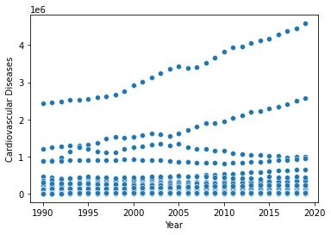
CARDIOVASCULAR DISEASES-
Here, we see that , maximum of this kind of deaths were caused in the year 2015-2020. The graph is sloping upwards which is dangerous.

Slide 52
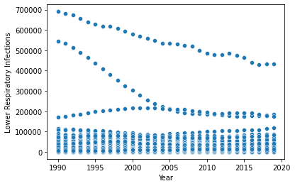
LOWER RESPIRATORY INFECTIONS-
Here, we see that , maximum of this kind of deaths were caused in the year 1990-1995. The graph is sloping downwards which is not dangerous.

Slide 53
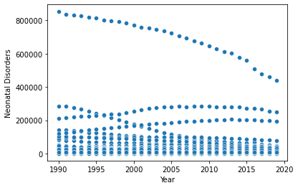
NEONATAL DISORDERS-
Here, we see that , maximum of this kind of deaths were caused in the year 1990-1995. The graph is sloping downwards which is not dangerous.

Slide 54
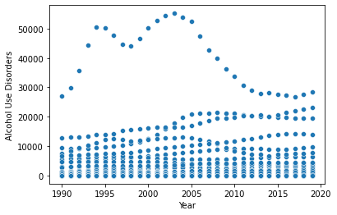
ALCOHOL USE DISORDERS-
Here, we see that , maximum of this kind of deaths were caused in the year 2000-2005. The graph is sloping downwards which is not dangerous.

Slide 55
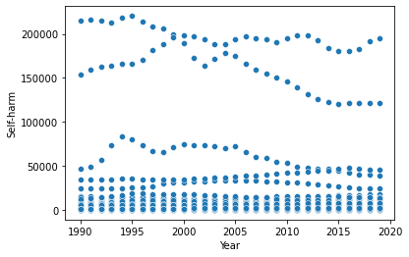
SELF-HARM-
Here, we see that , maximum of this kind of deaths were caused in the year 2000-2005. The graph is sloping downwards which is not dangerous.

Slide 56
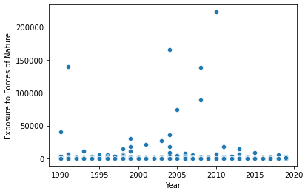
EXPOSURE TO FORCES OF NATURE-
Here we see that, this kind of disease is unevenly spread over the years and is not huge in number.

Slide 57
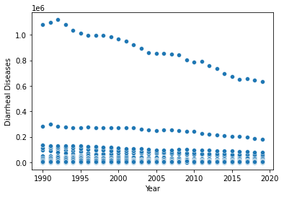
DIARRHEAL DISEASES-
Here, we see that , maximum of this kind of deaths were caused in the year 1990-1995. The graph is sloping downwards which is not dangerous.

Slide 58
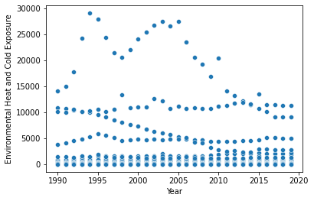
ENVIRONMENTAL HEAT AND COLD EXPOSURE-
Here, we see that , maximum of this kind of deaths were caused in the year 1995-2000. The graph is sloping downwards which is not dangerous.

Slide 59
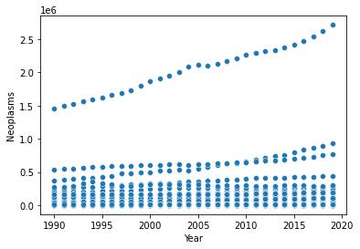
NEOPLASMS-
Here, we see that , maximum of this kind of deaths were caused in the year 2015-2020. The graph is sloping upwards which is dangerous.

Slide 60
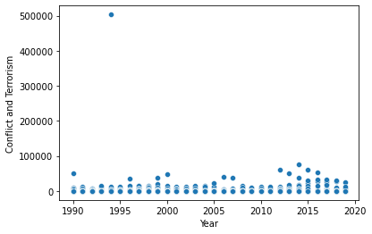
CONFLICT AND TERRORISM-
Here, we see that , maximum of this kind of deaths were caused in the year 2015-2020. The graph is sloping upwards which is dangerous.

Slide 61
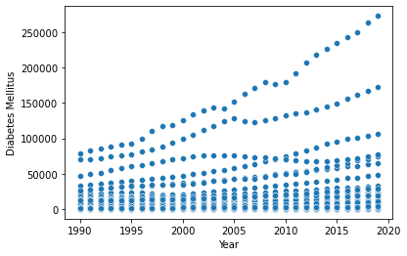
DIABETES MELLITUS-
Here, we see that , maximum of this kind of deaths were caused in the year 2015-2020. The graph is sloping upwards which is dangerous.

Slide 62
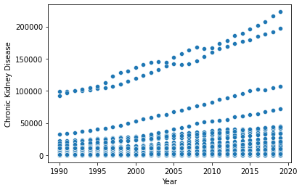
CHRONIC KIDNEY DISEASE-
Here, we see that , maximum of this kind of deaths were caused in the year 2015-2020. The graph is sloping upwards which is dangerous.

Slide 63
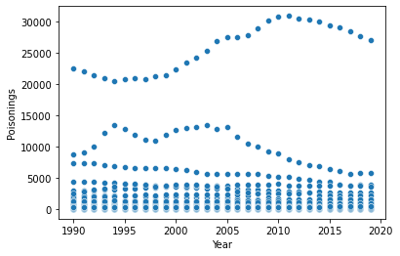
POISONINGS-
Here, we see that , maximum of this kind of deaths were caused in the year 2010-2015. The graph is sloping downwards which is not dangerous.

Slide 64
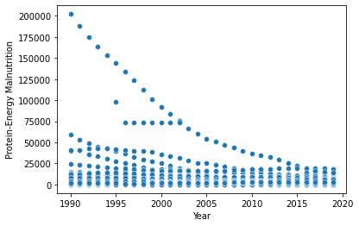
PROTEIN-ENERGY MALNUTRITION-
Here, we see that , maximum of this kind of deaths were caused in the year 1990-1995. The graph is sloping downwards which is not dangerous.

Slide 65
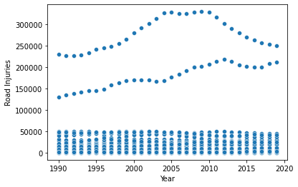
ROAD INJURIES-
Here, we see that , maximum of this kind of deaths were caused in the year 2005-2010. The graph is sloping downwards which is not dangerous.

Slide 66
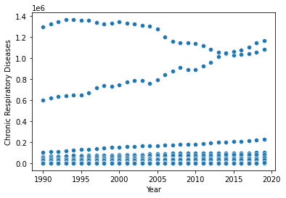
CHRONIC RESPIRATORY DISEASES-
Here, we see that , maximum of this kind of deaths were caused in the year 1995-2000. The graph is sloping downwards which is not dangerous.

Slide 67
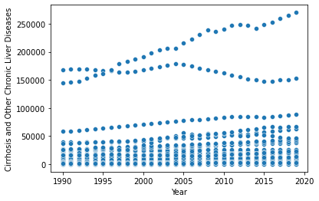
CIRRHOSIS AND OTHER CHRONIC LIVER DISEASES-
Here, we see that , maximum of this kind of deaths were caused in the year 2015-2020. The graph is sloping upwards which is dangerous.

Slide 68
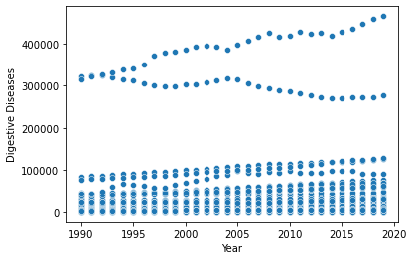
DIGESTIVE DISEASES-
Here, we see that , maximum of this kind of deaths were caused in the year 2015-2020. The graph is sloping upwards which is dangerous.

Slide 69
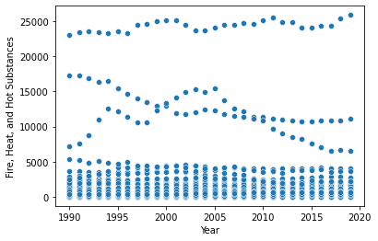
FIRE,HEAT, AND HOT SUBSTANCES-
Here, we see that , maximum of this kind of deaths were caused in the year 2015-2020. The graph is sloping upwards which is dangerous.

Slide 70

ACUTE HEPATITIS-
Here, we see that , maximum of this kind of deaths were caused in the year 1990-1995. The graph is sloping downwards which is not dangerous.

Slide 71
MULTIVARIATE ANALYSIS
We will use correlation between all columns for this.

Slide 72

CORRELATION USING HEATMAP-

Slide 73
3.3 DESCRIBING THE DATASET

Slide 74

Describing:
Describing the dataset gives us an understanding of various values like count of the attribute,mean of that attribute, standard deviation, minimum, 25th percentile, median/50th percentile, 75th percentile and the maximum value of that attribute. For this dataset, the mean is greater than the median which means its right skewed.

Slide 75
4. CONCLUSION AND FINDINGS

Slide 76
FINDINGS:
We see that, in this dataset the cause of death happened around the world has been due to many natural and unnatural reasons. We have to be mainly careful and precautionary regarding the diseases with upward sloping graphs like- diabetes, kidney malfunction, road injuries etc. We see due to strict Government rules and regulations, many causes have come under control like hunger, natural calamity, fire injuries, poisoning etc.

Slide 77
5. BIBLIOGRAPHY

Slide 78
References:
https://pbpython.com/pandas_dtypes.html
https://www.datasciencemadesimple.com/encode-decode-column-dataframe-python/#:~:text=encode%20%28%29%20function%20with%20codec%20%E2%80%98base64%E2%80%99%20and%20error,be%20Decode%20a%20column%20of%20dataframe%20in%20python%3A
https://www.kaggle.com/code/spscientist/a-simple-tutorial-on-exploratory-data-analysis
https://en.wikipedia.org/wiki/Exploratory_data_analysis#:~:text=In%20statistics%2C%20exploratory%20data%20analysis,and%20other%20data%20visualization%20methods.
https://ourworldindata.org/causes-of-death

Slide 79

THANK YOU!
PROJECT BY:-
Muskan Sureka
Internship Batch: 34

